Slide 1
Lab6 Polymorphism and Virtual Functions
DEE 1319
Department of Electronics Engineering
National Chiao Tung University

Slide 2
Learning Objectives
Polymorphism
Virtual functions
Abstract classes and pure virtual functions

Slide 3
Polymorphism
Polymorphism
While accessing a member function, the correct version based on the actual calling object is always invoked
Namely, the behavior of calling a member function through a pointer/reference may be different ➔ polymorphic
In C++, polymorphism is achieved through
Virtual functions, and
Manipulating objects through pointers or references
A class with virtual functions is called a polymorphic class
Polymorphism is another cornerstone of OOP

Slide 4
Virtual vs. Non-Virtual Functions (1/2)
For non-virtual (member) functions
Function calls are STATICALLY bound (i.e., bound at compile time)
class B {
public: void mf();
};
class D:public B {
public: void mf(); //redefine mf();
}
void f() {
B b, *pB= &b;
D d, *pD= &d;
b.mf(); // statically binding ➔ b is of type B ➔ call B::mf()
d.mf(); // statically binding ➔ d is of type D ➔ call D::mf()
pB->mf(); // statically binding ➔ pB is of type B* ➔ call B::mf()
pD->mf(); // statically binding ➔ pD is of type D* ➔ call D::mf()
pB= &d; // ok, D is derived from B
pB->mf(); // still statically binding ➔ pB is of type B* ➔ call B::mf()
} // though pB actually points to d (an object of type D)

Slide 5
Virtual vs. Non-Virtual Functions (2/2)
For virtual (member) functions
Must be non-static member functions
Function calls are DYNAMICALLY bound (i.e., bound at runtime) if they are invoked through pointers or references
class B {
public: virtual void mf();
};
void f() {
B b, *pB= &b;
D d, *pD= &d;
b.mf(); d.mf();
pB->mf(); pD->mf();
pB= &d; // ok, D is derived from B
pB->mf();// dynamically binding ➔ pB actually points to d ➔ call D::mf()
}
class D:public B {
public: void mf(); //override mf();
}

Slide 6
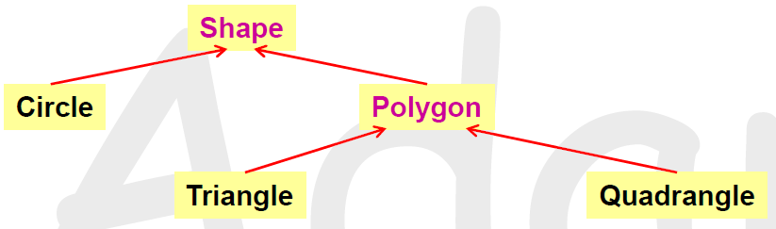
Concrete Class vs. Abstract Class
Some concepts are concrete and some are abstract
Abstract classes: Shape and Polygon
e.g., no idea how to draw or rotate an arbitrary shape
Objects of abstract classes should not exist (they are abstract)
Concrete classes : Circle, Triangle and Quadrangle
Objects of these types can exist
They can be drawn, rotated, …

Slide 7
Pure Virtual Functions & Abstract Class
class Shape {
public:
virtual void rotate(int) = 0; // pure virtual function
virtual void draw() = 0; // pure virtual function
virtual bool is_closed() = 0; // pure virtual function
// … // only declaration; no definition
};
void f() {
Shape s; // compilation error! it must be an error, or
s.draw(); //would be legal ; but draw() is a pure virtual function
};
A class with one or more pure virtual functions is called an abstract class
No objects of abstract class can be created in C++

Slide 8
Abstract Base Class (ABC)
Abstract class is always used as a base class ➔(ABC)
You cannot create objects of abstract class
It only makes sense that some classes derived from it and become concrete by overriding all pure functions
Abstract class specifies interface requirements
A class derived from an ABC is still abstract if it doesn’t override ALL inherited pure virtual functions

Slide 9
Lab6 Exercise
Input: A set of shapes with side-information
Shape type: triangle, rectangle, square and circle
Output:
1) Calculate the perimeter of each shape.
2) Check if the shapes are legal or illegal, and classify these shapes as the output.
The rules are the below:
For all shapes, all the numbers (length of size and radius) are greater than 0.
For triangles, the sum of any two of the sizes is always greater then the other side.
For rectangles, the up-side = down-side and right-side = left-side
For squares, the four sides are identical

Slide 10
Format of Input
10 //total number of shapes
Shape0 // [shape name]
triangle // [shape type]
3 3 2 //side lengths
Shape1 //[shape name]
circle // [shape type]
4 //radius
Shape2 //[shape name]
rectangle // [shape type]
3 4 3 4 //always in the order: up, right, down, and left
… …

Slide 11
Constraints
The inheritance hierarchy should be:
shape and polygon should be abstract base class
Set pi = 3.14
Set the perimeter of the illegal ones -1
shape
polygon
circle
triangle
rectangle
square

Slide 12
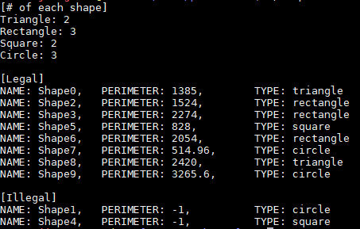
Output Format

Slide 13
Lab6 Homework
You need to design a pokemon-attack system
Input: A set of pokemons with four skills.
Pokemon type: normal (0), fire (1), water (2) and grass (3)
Skill: skill’s name and skill’s damage
Level: 1~99
Base Skill’s damage = skill’s damage + skill’s damage *level/400
HP=15+level*2
Output: All pokemons and their skill(after input all pokemon), each round’s result(each round). Finally, print all pokemons with their HP(if it is alive), “[pokemon_name] lose ability to fight!!”(if it’s HP<=0)

Slide 14
Lab6 Homework - Procedure
First, input a set of pokemons. (must greater than 2)
Second, choose any two of the pokemons to battle by using their skills each round.
If anyone of the pokemon lose ability to fight, the battle will be stopped.
Finally, display the result of the battle.

Slide 15
Format of input (pokemon)
2 //[Number of pokemon] (greater than2)
Pikachu 80 0 //[Name] [level] [Type]
Thunder_Shock 40 //[Skill’s name] [Skill’s damage]
Thunder 110
Iron_Tail 100
Quick_Attack 40
Charizrd 99 1 //[Name] [level] [Type]
Sunny_Day 0 //[Skill’s name] [Skill’s damage]
Fire_Punch 75
Fire_Burst 70
Mach_Punch 40
pokemon1
pokemon2

Slide 16
Format of Input (Battle)
4 //[Number of Round]
1 3 //[Pokemon’s Number] [Skill’s number]
2 4 //each round need two commends
1 2
2 1
1 4
2 3
1 2
2 4
round1
round2
round3
round4

Slide 17
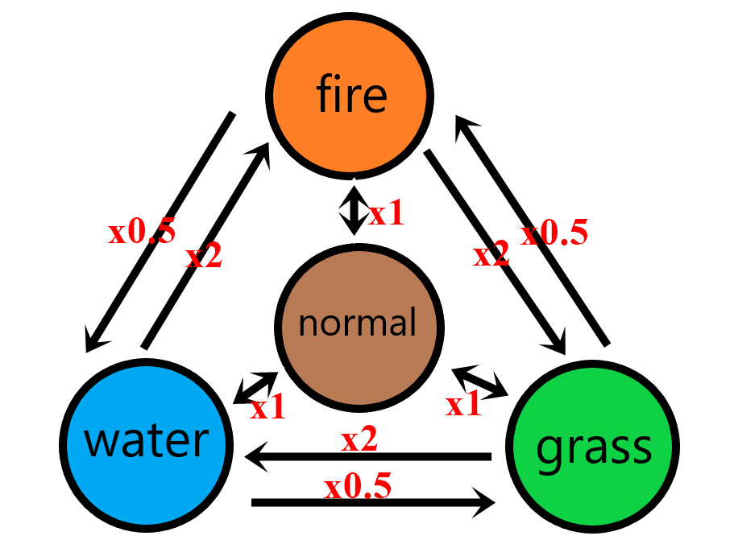
Lab6 Homework – Attack function
You need to write an “Attack function” to decrease the HP of the pokemon.
The following figure is the damage computation of types.

Slide 18
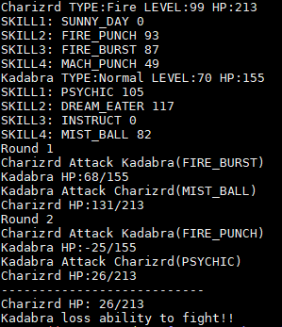
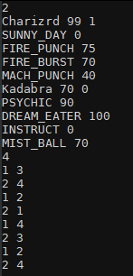
Format of output
Input data set
Print after input all the pokemon
Print the result after each round
Print all pokemon’s status after battle
There will be no point if the output format is wrong !

